Slide 1
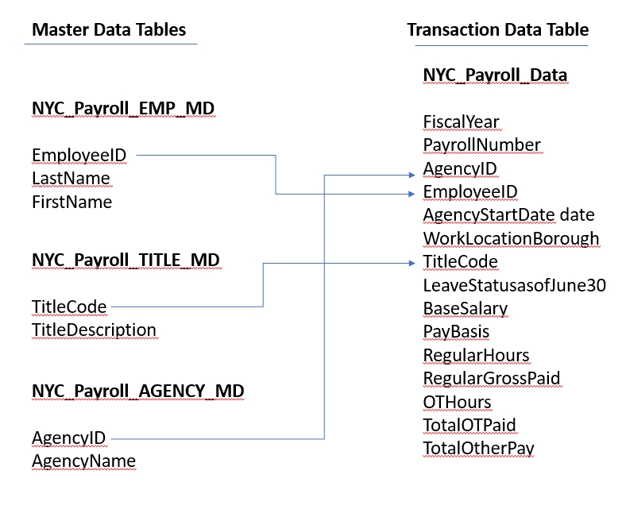

Project: Data Integration Pipelines for NYC Payroll Data Analytics
Project Introduction
The City of New York would like to develop a Data Analytics platform on Azure Synapse Analytics to accomplish two primary objectives:
Analyze how the City's financial resources are allocated and how much of the City's budget is being devoted to overtime.
Make the data available to the interested public to show how the City’s budget is being spent on salary and overtime pay for all municipal employees.
You have been hired as a Data Engineer to create high-quality data pipelines that are dynamic, can be automated, and monitored for efficient operation. The project team also includes the city’s quality assurance experts who will test the pipelines to find any errors and improve overall data quality.
The source data resides in Azure Data Lake and needs to be processed in a NYC data warehouse in Azure Synapse Analytics. The source datasets consist of CSV files with Employee master data and monthly payroll data entered by various City agencies.

Slide 2
Project: Data Integration Pipelines for NYC Payroll Data Analytics
Project Environment
For this project, you'll do your work in the Azure Portal, using several Azure resources including:
Azure Data Lake Gen2 (Storage account with Hierarchical Namespaces checkbox checked when creating)
Azure SQL DB
Azure Data Factory
Azure Synapse Analytics
Instructions for using a temporary Azure account to complete the project are on the next page.
You'll take screenshots as proof of work for this project, so remember to collect these screenshots throughout the project steps. A checklist is provided at the end of each step so you can double-check you've collected all of the deliverables.
You'll also need to create a Github repository for this project. At the end of the project, you will connect your Azure pipelines to Github and submit the URL or contents of the repository.
Project Data
Download these .csv files that provide the data for the project.

Slide 3
Project: Data Integration Pipelines for NYC Payroll Data Analytics
Project Instructions
For this project, you'll do your work in the Azure Portal, using several Azure resources including:
Azure Data Lake Gen2
Azure SQL DB
Azure Data Factory
Azure Synapse Analytics
Instructions for using a temporary Azure account to complete the project are on the previous page.
You'll take screenshots as proof of work for this project, so remember to collect these screenshots throughout the project steps. A checklist is provided at the end of each step so you can double-check you've collected all of the screenshot deliverables.
You'll also need to create a Github repository for this project. At the end of the project, you will connect your Azure pipelines to Github and submit the URL or contents of the repository.
When you submit your project, it will be assessed against this project rubric. Take a moment to review it now and periodically throughout the project to make sure you're meeting the requirements.
Project Data
Download these .csv files that provide the data for the project.

Slide 4
Project: Data Integration Pipelines for NYC Payroll Data Analytics
Step 1: Prepare the Data Infrastructure
Setup Data and Resources in Azure
1.Create the data lake and upload data
Log into your temporary Azure account (instructions on the previous page) and create the following resources. Please use the provided resource group to create each resource. You will use these resources for the whole project, in all of the steps, so you'll only need to create one of each:
Create an Azure Data Lake Storage Gen2 (storage account) and associated storage container resource named adlsnycpayroll-yourfirstname-lastintial. Create three directories in this storage container named
dirpayrollfiles
dirhistoryfiles
dirstaging
Upload these files from the project data to the dirpayrollfiles folder
EmpMaster.csv
AgencyMaster.csv
TitleMaster.csv
nycpayroll_2021.csv
Upload this file (historical data) from the project data to the dirhistoryfiles folder
nycpayroll_2020.csv

Slide 5
Project: Data Integration Pipelines for NYC Payroll Data Analytics
2. Create an Azure Data Factory Resource
3. Create a SQL Database to store the current year of the payroll data
In the Azure portal, create a SQL Database resource named db_nycpayroll
Add client IP address to the SQL DB firewall
Create a table called NYC_Payroll_Data in db_nycpayroll in the Azure Query Editor with this SQL Script:
CREATE TABLE [dbo].[NYC_Payroll_Data](
[FiscalYear] [int] NULL, [PayrollNumber] [int] NULL, [AgencyID] [varchar](10) NULL, [AgencyName] [varchar](50) NULL, [EmployeeID] [varchar](10) NULL, [LastName] [varchar](20) NULL, [FirstName] [varchar](20) NULL,
[AgencyStartDate] [date] NULL, [WorkLocationBorough] [varchar](50) NULL, [TitleCode] [varchar](10) NULL, [TitleDescription] [varchar](100) NULL, [LeaveStatusasofJune30] [varchar](50) NULL, [BaseSalary] [float] NULL,
[PayBasis] [varchar](50) NULL, [RegularHours] [float] NULL, [RegularGrossPaid] [float] NULL, [OTHours] [float] NULL, [TotalOTPaid] [float] NULL, [TotalOtherPay] [float] NULL
)
GO

Slide 6
Project: Data Integration Pipelines for NYC Payroll Data Analytics
4. Create A Synapse Analytics workspace, or use one you already have created.
Create a new Azure Data Lake Gen2 and file system for Synapse Analytics when you are creating the Synapse Analytics workspace in the Azure portal.
Create a SQL dedicated pool in the Synapse Analytics workspace
Select DW100c as performance level. Keep defaults for other settings.
In the SQL dedicated pool, Create master data tables and payroll transaction tables using these SQL scripts (You can execute all four sql scripts at same time) :
Create Emplyee Master Data table:
CREATE TABLE [dbo].[NYC_Payroll_EMP_MD]( [EmployeeID] [varchar](10) NULL, [LastName] [varchar](20) NULL, [FirstName] [varchar](20) NULL ) GO
Create Job Title Table:
CREATE TABLE [dbo].[NYC_Payroll_TITLE_MD]( [TitleCode] [varchar](10) NULL, [TitleDescription] [varchar](100) NULL ) GO
Create Agency Master table:
CREATE TABLE [dbo].[NYC_Payroll_AGENCY_MD]( [AgencyID] [varchar](10) NULL, [AgencyName] [varchar](50) NULL ) GO

Slide 7
Project: Data Integration Pipelines for NYC Payroll Data Analytics
Create Payroll transaction data table:
CREATE TABLE [dbo].[NYC_Payroll_Data](
[FiscalYear] [int] NULL, [PayrollNumber] [int] NULL, [AgencyID] [varchar](10) NULL,
[AgencyName] [varchar](50) NULL, [EmployeeID] [varchar](10) NULL,
[LastName] [varchar](20) NULL, [FirstName] [varchar](20) NULL, [
AgencyStartDate] [date] NULL, [WorkLocationBorough] [varchar](50) NULL,
[TitleCode] [varchar](10) NULL, [TitleDescription] [varchar](100) NULL,
[LeaveStatusasofJune30] [varchar](50) NULL, [BaseSalary] [float] NULL,
[PayBasis] [varchar](50) NULL, [RegularHours] [float] NULL, [RegularGrossPaid] [float] NULL,
[OTHours] [float] NULL, [TotalOTPaid] [float] NULL, [TotalOtherPay] [float] NULL ) GO

Slide 8
Project: Data Integration Pipelines for NYC Payroll Data Analytics
Step 2: Create Linked Services
1.Create a Linked Service for Azure Data Lake
In Azure Data Factory, create a linked service to the data lake that contains the data files
From the data stores, select Azure Data Lake Gen 2
Test the connection
2.Create a Linked Service to SQL Database that has the current (2021) data
If you get a connection error, remember to add the IP address to the firewall settings in SQL DB in the Azure Portal
3. Create a Linked Service for Synapse Analytics
Create the linked service to the SQL pool.

Slide 9
Project: Data Integration Pipelines for NYC Payroll Data Analytics
Step 3: Create Datasets in Azure Data Factory
1.Create the datasets for the 2021 Payroll file on Azure Data Lake Gen2
Select DelimitedText
Set the path to the nycpayroll_2021.csv in the Data Lake
Preview the data to make sure it is correctly parsed
2. Repeat the same process to create datasets for the rest of the data files in the Data Lake
EmpMaster.csv
TitleMaster.csv
AgencyMaster.csv
Remember to publish all the datasets
3. Create the dataset for transaction data table that should contain current (2021) data in SQL DB
4. Create the datasets for destination (target) tables in Synapse Analytics
dataset for NYC_Payroll_EMP_MD
for NYC_Payroll_TITLE_MD
for NYC_Payroll_AGENCY_MD
for NYC_Payroll_Data

Slide 10
Project: Data Integration Pipelines for NYC Payroll Data Analytics
Step 4: Create Data Flows
1.In Azure Data Factory, create the data flow to load 2021 Payroll Data to SQL DB transaction table (in the future NYC will load all the transaction data into this table).
Create a new data flow
Select the dataset for the 2021 payroll file as the source
Select the sink dataset as the payroll table on SQL DB
Make sure to reassign any missing source to target mappings
2.Create Pipeline to load 2021 Payroll data into transaction table in the SQL DB
Create a new pipeline
Select the data flow to load the 2021 file into SQLDB
Trigger the pipeline
Monitor the pipeline
Take a screenshot of the Azure Data Factory screen pipeline run after it has finished.
Make sure the data is successfully loaded into the SQL DB table

Slide 11
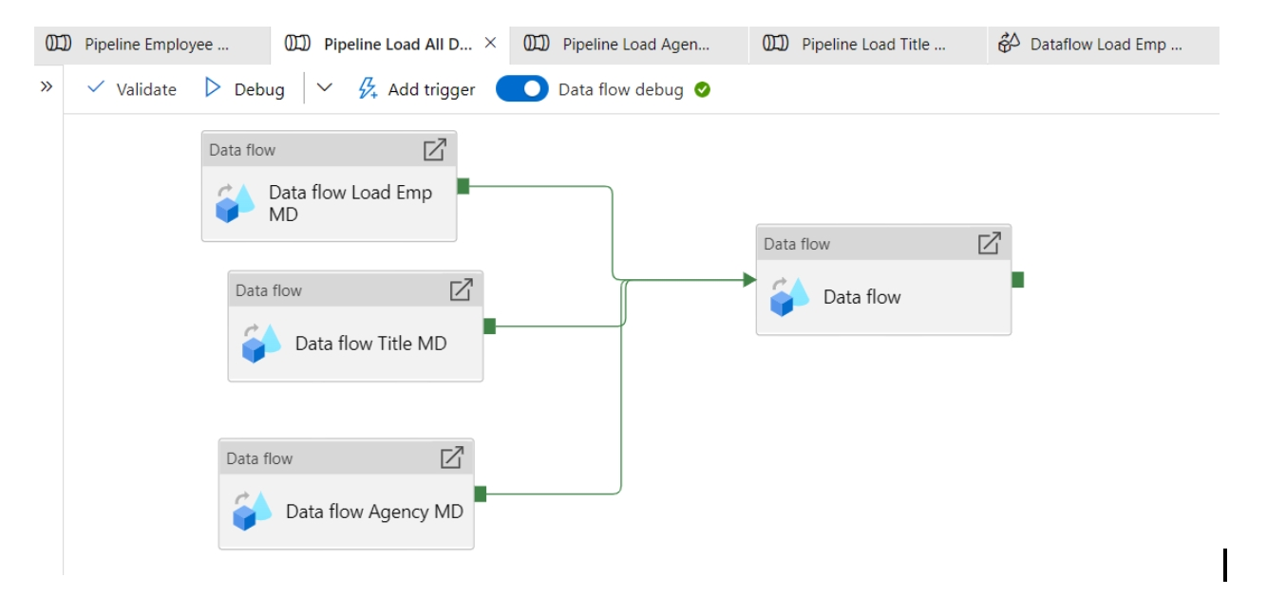
Project: Data Integration Pipelines for NYC Payroll Data Analytics
3. Create data flows to load the data from the data lake files into the Synapse Analytics data tables
Create the data flows for loading Employee, Title, and Agency files into corresponding SQL pool tables on Synapse Analytics
For each Employee, Title, and Agency file data flow, sink the data into each target Synaspe table
4. Create a data flow to load 2021 data from SQL DB to Synapse Analytics
5. Create pipelines for Employee, Title, Agency, and year 2021 Payroll transaction data to Synapse Analytics containing the data flows.
Select the dirstaging folder in the data lake storage for staging
Optionally you can also create one master pipeline to invoke all the Data Flows
Validate and publish the pipelines
6. Trigger and monitor the Pipelines
Take a screenshot of each pipeline run after it has finished, or one after your master pipeline run has finished.
In total, you should have 6 pipelines or one master pipeline

Slide 12
Project: Data Integration Pipelines for NYC Payroll Data Analytics
Step 5: Data Aggregation and Parameterization
In this step, you'll extract the 2021 year data and historical data, merge, aggregate and store it in Synapse Analytics. The aggregation will be on Agency Name, Fiscal Year and TotalPaid.
1.Create a Summary table in Synapse with the following SQL script and create a dataset named table_synapse_nycpayroll_summary
CREATE TABLE [dbo].[NYC_Payroll_Summary]( [FiscalYear] [int] NULL, [AgencyName] [varchar](50) NULL, [TotalPaid] [float] NULL )
2.Create a new dataset for the Azure Data Lake Gen2 folder that contains the historical files.
Select dirhistoryfiles in the data lake as the source
3.Create new data flow and name it Dataflow Aggregate Data
Create a data flow level parameter for Fiscal Year
Add first Source for table_sqldb_nyc_payroll_data table
Add second Source for the Azure Data Lake history folder
4.Create a new Union activity in the data flow and Union with history files
5.Add a Filter activity after Union
In Expression Builder, enter toInteger(FiscalYear) >= $dataflow_param_fiscalyear

Slide 13
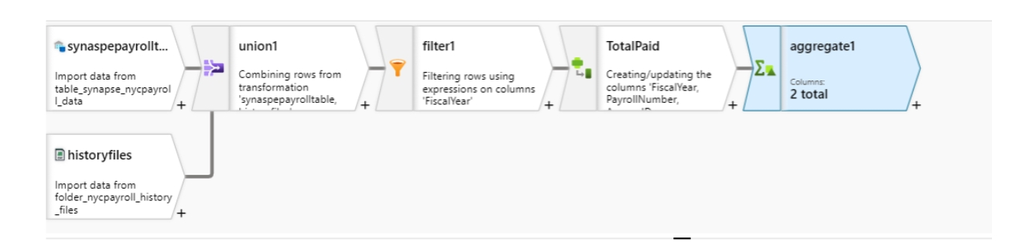
Project: Data Integration Pipelines for NYC Payroll Data Analytics
6.Derive a new TotalPaid column
In Expression Builder, enter RegularGrossPaid + TotalOTPaid+TotalOtherPay
7.Add an Aggregate activity to the data flow next to the TotalPaid activity
Under Group By, Select AgencyName and Fiscal Year
8.Add a Sink activity to the Data Flow
Select the dataset to target (sink) the data into the Synapse Analytics Payroll Summary table.
In Settings, select Truncate Table
9.Create a new Pipeline and add the Aggregate data flow
Create a new Global Parameter (This will be the Parameter at the global pipeline level that will be passed on to the data flow
In Parameters, select Pipeline Expression
Choose the parameter created at the Pipeline level
10.Validate, Publish and Trigger the pipeline. Enter the desired value for the parameter.
11.Monitor the Pipeline run and take a screenshot of the finished pipeline run.

Slide 14
Project: Data Integration Pipelines for NYC Payroll Data Analytics
Step 6: Connect your Project to Github
In this step, you'll connect Azure Data Factory to Github
Login to your Github account and create a new Repo in Github
Connect Azure Data Factory to Github
Select your Github repository in Azure Data Factory
Publish all objects to the repository in Azure Data Factory
Take a moment to review the project rubric and make sure you've completed all the requirements
Download your project repository from Github and submit your repository and screenshots of your pipeline runs.

